Slide 1
Software Process Models
Instructor: Mehroze Khan

Slide 2
What is Agile ?
An iterative approach to project management that helps teams be responsive and deliver value to their customers faster.

Slide 3
Key Characteristics of Agile Development
Adaptive Planning
Evolutionary Development
Early Delivery
Continual Improvement
Responsiveness to change

Slide 4
The Manifesto for Agile Software Development
Agile manifesto
Concentrate on responding to change rather than on creating a plan and then following it.
Value individuals and interactions over process and tools
Prefer to invest time in producing working software rather than in producing comprehensive documentation
Focus on customer collaboration rather than contract negotiation

Slide 5
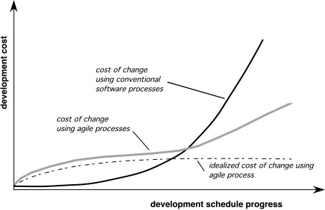
Agility and the Cost of Change

Slide 6
Human Factors
Key traits must exist among the people on an agile team and the team itself:
Competence.
Common focus.
Collaboration.
Decision-making ability.
Fuzzy problem-solving ability.
Mutual trust and respect.
Self-organization.

Slide 7
Extreme Programming (XP)
The most widely used agile process, originally proposed by Kent Beck
XP Planning
Begins with the creation of “user stories”
Each user story is written by the customer and is placed on an index card. The customer assigns a value (a priority) to the story based on the overall business value of the feature or function.
Agile team assesses each story and assigns a cost (measured in development weeks)
Stories are grouped to form a deliverable increment
A commitment is made on delivery date
After the first increment “project velocity” (number of customer stories implemented during the first release) is used to help define subsequent delivery dates for other increments
Notes:
Once a basic commitment (agreement on stories to be included, delivery date, and other project matters) is made for a release, the XP team orders the stories that will be developed in one of three ways:
all stories will be implemented immediately (within a few weeks)
the stories with highest value will be moved up in the schedule and implemented first
the riskiest stories will be moved up in the schedule and implemented first.

Slide 8
Extreme Programming (XP)
XP Design
Follows the Keep It Simple (KIS) principle. The design of extra functionality (because the developer assumes it will be required later) is discouraged
Encourage the use of CRC cards. CRC (class-responsibility collaborator) cards; identify and organize the object-oriented classes that are relevant to the current software increment.
For difficult design problems, suggests the creation of “spike solutions”—a design prototype.
Refactoring—modifying/optimizing the code in a way that does not change the external behavior of the software

Slide 9
Extreme Programming (XP)
XP Coding
Recommends the construction of unit tests for each user story before coding commences.
Once the unit test has been created, the developer is better able to focus on what must be implemented to pass the test.
Encourages “pair programming”; two people work together at one computer workstation to create code for a story. Provides a mechanism for real-time problem solving and real-time quality assurance.
Continuous Integration: As pair programmers complete their work, the code they develop is integrated with the work of others to uncover compatibility and interfacing errors.

Slide 10
Extreme Programming (XP)
XP Testing
Unit tests are executed repeatedly
XP acceptance tests, also called customer tests, are specified by the customer and focus on overall system features and functionality that are visible and reviewable by the customer.

Slide 11
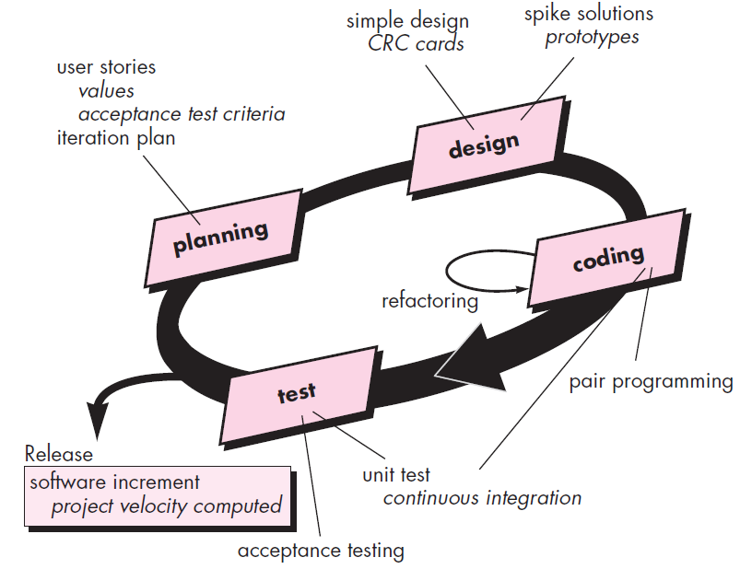
Extreme Programming (XP)

Slide 12
References
Shari PFleeger, Joanne Atlee, Software Engineering: Theory and Practice, 4th Edition
Roger S. Pressman, Software Engineering A Practitioner’s Approach, 9th Edition. McGrawHill

